Slide 1

license plate detection
IPM-18AUTISPG 1 - Image and Signal Processing
I2A52J – GERELMAA BATTSETSEG

Slide 2
Contents
About topic
Used functions
Conclusion

Slide 3
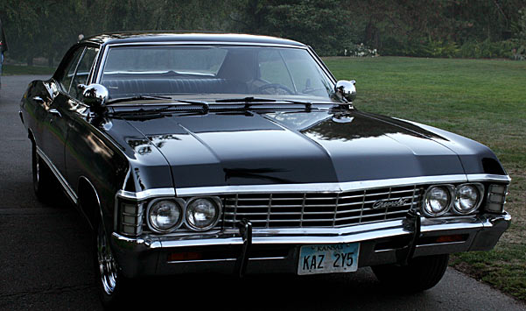

About a topic
Detect and recognize license plates
Segment license plates, process them, and recognize their labels.

Slide 4
Implementation plan
Detection
Otsu's thresholding #black and white
Morphological operations #fill holes
Separate letters
Histogram adjustment, thresholding
Characters
OCR #Matlab method
Edge and Line detections
connected component analysis
Character detection # implement manually

Slide 5
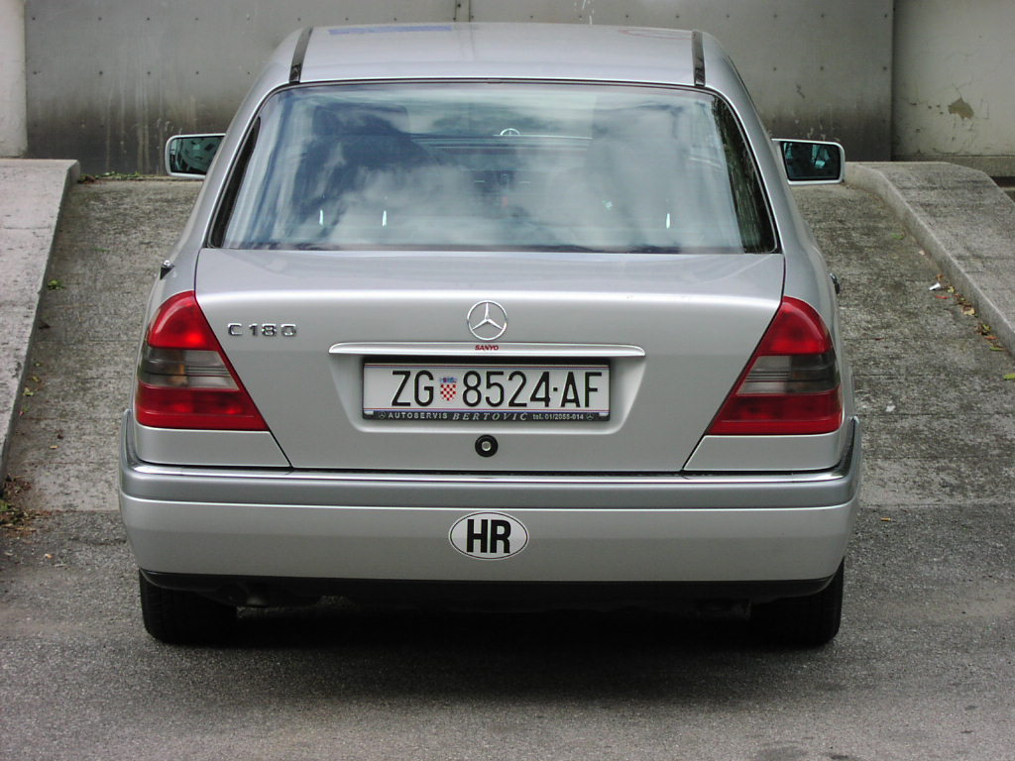
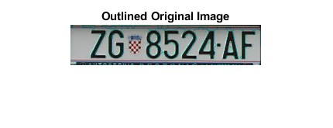

Conclusion
During this class I tried understand theorical knowledge and their applications. Then I used on my project.
I will be mention about problems during the implementation procedure

Slide 6
Thank you for your
attention!

